Slide 1

Mini-Project 1
Gate-level netlist to def parser

Slide 2

Inputs and Outputs
Inputs:
Gate-level netlist in JSON format
LEF file
Standard Cell library (liberty file)
Design options
Outputs:
DEF file with the following sections
Parsing rules
Die area
Rows
Components
PINS
NETS
Special NETS (VDD, GND)

Slide 3
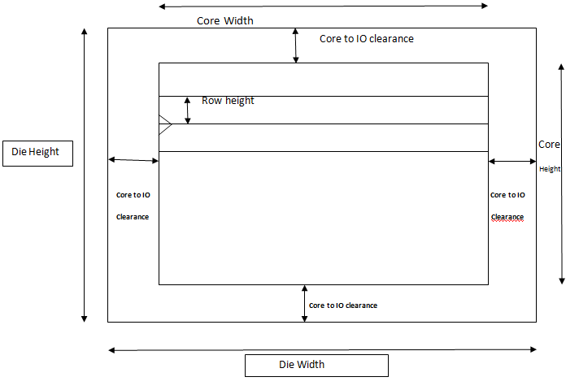
Die Area
DEF file specifies the lower left and upper right corner coordinates of the total die area.
Die area = Die width * Die height
Aspect ratio = Die Height/Die width
Die width = sqrt(Die area/Aspect ratio)
*Die width and height must be multiples of site width and height respectively

Slide 4
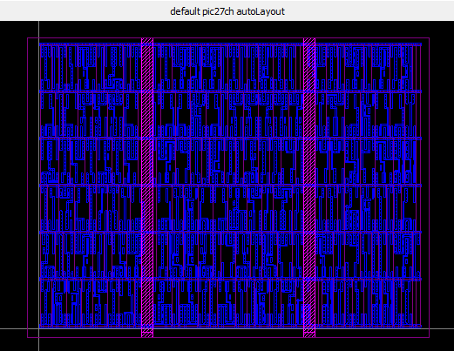
Components
Each cell used in the GL-netlist is searched in the LEF and written in def file with the appropriate type.

Slide 5
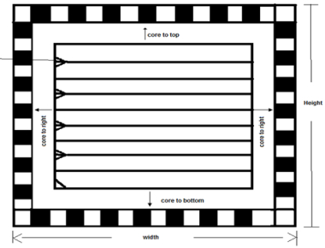
Rows
The die is divided into horizontal rows, were sites are placed beside each others.
Number of rows in calculated as follows:
# rows = Die height/ Site height

Slide 6
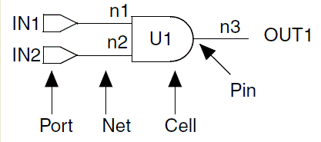
NETS
Internal and external connections
Search for nets in GL-Netlist JSON, check connected cells and list all nets, their connected cells/pins and the direction in which they are connected.
Example:
- a<1>
( AOI22X1_1 A )
( PIN a<1> )

Slide 7
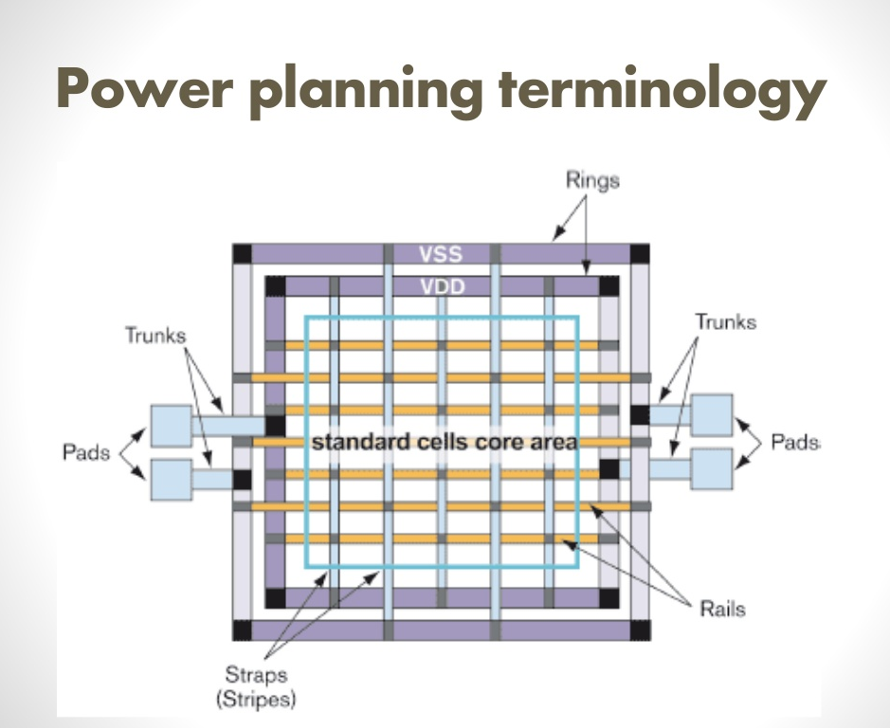
Power rings
Power Rings are, vdd and gnd, placed around the core area.
Metal spacings are extracted from the LEF file to separate gnd and vdd

